Slide 1
Azure Synapse Analytics Evolução do Azure SQL Data Warehouse
Sidney Cirqueira– Microsoft Learn Student Ambassador

Slide 2










Sidney Cirqueira
Analista de Dados & AI – Lanlink;
Microsoft MCT;
Microsoft Learn Student Ambassador;
Pós - Graduando em Big Data & Machine Learning - FASAM;
Experiência focada em Engenharia de Dados e IA no MS Azure;
Ciclista / Futevôlei

Slide 3
Agenda
O que é Azure Synapse Analytics;
Synapse Analytics (SQL DW) – GA – “v1”;
Synapse Analytics (Workspace) – Preview – “v2”;
Features;
Demo;
Referencias.

Slide 4
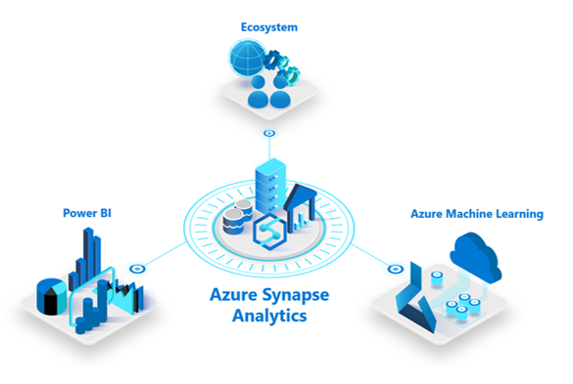
O que é o Azure Synapse Analytics?
SERVIÇO ILIMITADO DE ANALYTICS QUE TRAZ JUNTO DATA WAREWOUSE EMPRESARIAL E ANALISE DE BIG DATA COM UMA INTERFACE ÚNICA DE INGESTÃO, PREPARAÇÃO, GERENCIAMENTO E DISPONIBILIZAÇÃO DOS DADOS PARA NECESSIDADES DE BUSINESS INTELLIGENCE E MACHINE LEARNING.
Notes:
-Reconhecimento de Imagem -Predição -Classificação

Slide 5





Arquitetura de Data Warehouse moderno
Ingest & Prep
Model & Serve
Visualize
Logs (unstructured)
Azure Data Factory
Azure SQL Data Warehouse
Code-free data ingestion from 85+ data integration connectors
Power BI
Media (unstructured)
Up to 14x faster and costs 94% less than other cloud providers
Leader in the Magic Quadrant for Business Intelligence and Analytics Platforms*
Azure Databricks
(Prep-only)
Files (unstructured)
Business/ custom apps (structured)
Store
Azure Data Lake Storage
High performance data lake available in all 54 Azure regions
https://gigaom.com/report/data-warehouse-cloud-benchmark/
Notes:
5

Slide 6
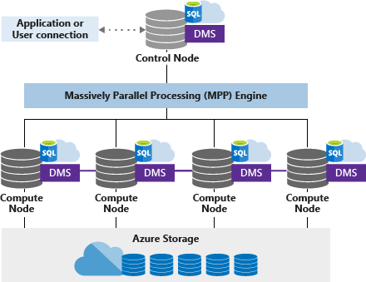
Arquitetura MPP – Massively Parallel Processing

Slide 7
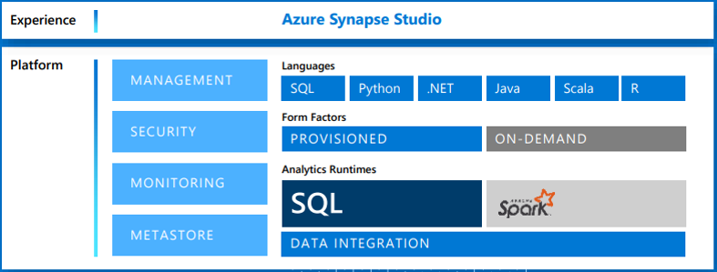

Azure Synapse Analytics – v2
Logs (unstructured)
Azure
Synapse
Analytics
Media (unstructured)
Azure Machine Learning
Brings together enterprise data warehousing and Big Data analytics
Files (unstructured)
Business/ custom apps (structured)
Store
Power BI
Azure Data Lake Storage
High performance data lake available in all 54 Azure regions
Notes:
unified experience to ingest, prepare, manage, and serve data for immediate BI and machine learning needs.
7

Slide 8
Azure Synapse Analytics – Features
Limitless Scale
GA
Provisioned Compute
Materialized views
Result-set cache
Workload importance
Workload isolation
Powerful insights
Preview
Power BI integration
Azure Machine Learning integration
Stream analytics (data warehouse)
Apache Spark integration
Instant Clarity
Preview
Azure Synapse Link
Unmatched security
GA
Column and row-level security
Dynamic data masking
Private endpoints
Unified experience
Preview
Hybrid data ingestion
Azure Synapse Studio
Preview
Serverless data lake Exploration
Notes:
8

Slide 9
Demo
Notes:
-Reconhecimento de Imagem -Predição -Classificação

Slide 10
Referências
Microsoft Learn: https://docs.microsoft.com/en-us/learn/paths/implement-sql-data-warehouse/
Synapse Analytics (workspaces): https://docs.microsoft.com/en-us/azure/synapse-analytics/overview-what-is
Synapse Analytics(SQL DW): https://docs.microsoft.com/en-us/azure/synapse-analytics/sql-data-warehouse/
Modern Data Warehouse: https://azure.microsoft.com/en-in/solutions/architecture/modern-data-warehouse/
MPP Architecture: https://docs.microsoft.com/en-us/azure/synapse-analytics/sql-data-warehouse/massively-parallel-processing-mpp-architecture
Product: https://azure.microsoft.com/en-us/services/synapse-analytics/
Synapse Link: https://docs.microsoft.com/en-us/azure/cosmos-db/synapse-link
Benchmark Cloud DW: https://azure.microsoft.com/en-us/services/synapse-analytics/compare/
Synapse Analytics Toolkit: https://azure.microsoft.com/en-us/resources/azure-synapse-analytics-toolkit/

Slide 11



Obrigado! =D
sidney.cirqueira@studentambassadors.com
https://github.com/sidneyocirqueira/azure-synapse-analytics
Notes:
-Reconhecimento de Imagem -Predição -Classificação

Slide 13
Texto
Texto
Notes:
-Reconhecimento de Imagem -Predição -Classificação

Slide 14
Texto
Texto
Notes:
-Reconhecimento de Imagem -Predição -Classificação

Slide 15
Texto
Texto
Notes:
-Reconhecimento de Imagem -Predição -Classificação

Slide 16
Texto
Texto
Notes:
-Reconhecimento de Imagem -Predição -Classificação

Slide 17
Texto
Texto
Notes:
-Reconhecimento de Imagem -Predição -Classificação

